Slide 1

Introduction to web programming.
What is a web server?In simple language a machine that takes the request on the internet and delivers you the requested page.It stores all the data of a website.A web server is just like a simple computer with additional software like Apache,Mysql and few others.

Slide 2
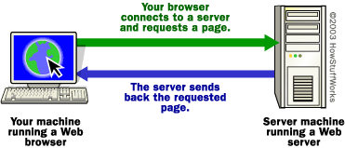
Diagrammatic representation of web server and client request.

Slide 3
Lets see what happens in detail.
Lets take example of http://www.w3schools.com/default.asp
If you want to get into a bit more detail on the process of getting a Web page onto your computer screen, here are the basic steps that occurred behind the scenes:The browser broke the URL into three parts:
The protocol ("http")
The server name ("www.w3schools.com")
The file name (“default.asp")
The browser communicated with a name server to translate the server name "www.w3schools.com" into an IP Address, which it uses to connect to the server machine.
The browser then formed a connection to the server at that IP address on port 80. (We'll discuss ports later in this article.)
Following the HTTP protocol, the browser sent a GET request to the server, asking for the file http://www.w3schools.com/default.asp
The server then sent the HTML/javascript text for the Web page to the browser. The browser read the HTML tags and JavaScript code and formatted the page onto your screen.

Slide 4
Clients and servers.
In general, all of the machines on the Internet can be categorized as two types: servers and clients.
Those machines that provide services (like Web servers) to other machines are servers. And the machines that request data from them are clients.Like your browser.

Slide 5
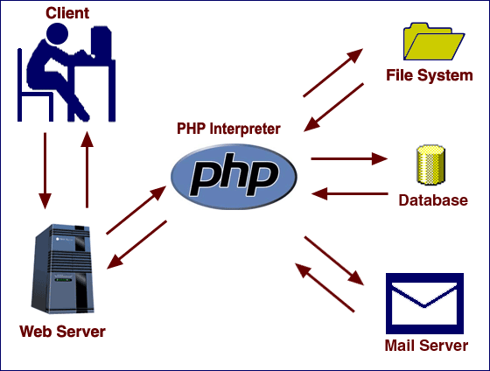
PHP working….

Slide 6
Working of PHP
When a user navigates in her browser to a page that ends with a .php extension, the request is sent to a web server, which directs the request to the PHP interpreter.
As shown in the next diagram, the PHP interpreter processes the page, communicating with file systems, databases, and email servers as necessary, and then delivers a web page to the web server to return to the browser.

Slide 7
About php.ini file.
Before we understand PHP syntax, I should briefly mention the php.ini file. This is a plain text file that is used to configure PHP. When the PHP interpreter is started, it reads the php.ini file to determine what settings to use. In simple words it is a file that tells php how to behave and what configuration settings to use.like how much memory should be used,maximum size that should be allowed to be uploaded(like in gmail you can not upload a file more than 10 mb) and so on.

Slide 8
About Javascript
JavaScript is what is called a Client-side Scripting Language. That means that it is a computer programming language that runs inside an Internet browser (a browser is also known as a Web client because it connects to a Web server to download pages).
The way JavaScript works is interesting. Inside a normal Web page you place some JavaScript code. When the browser loads the page, the browser has a built-in interpreter that reads the JavaScript code it finds in the page and runs it.
Web page designers use JavaScript in many different ways. One of the most common is to do field validation in a form. Many Web sites gather information from users in online forms, and JavaScript can help validate entries. For example, the programmer might validate that a person's age entered into a form falls between 1 and 120.
JavaScript is the recent buzz in technology and u may expect many questions based on JavaScript.

Slide 9
Usages.
Web sites use JavaScript to create a variety of special effects. Many sites use the program to create mouseovers, special effects that change the look of buttons, for example, when the mouse cursor runs over them. Some sites get very creative with this effect.

